Slide 1
SELF-SERVICE BI – DATA MODELING
Notes:
Welcome everybody to the session.

Slide 2
SELF-SERVICE BI WHY DATA MODELING IS STILL IMPORTANT

Slide 3
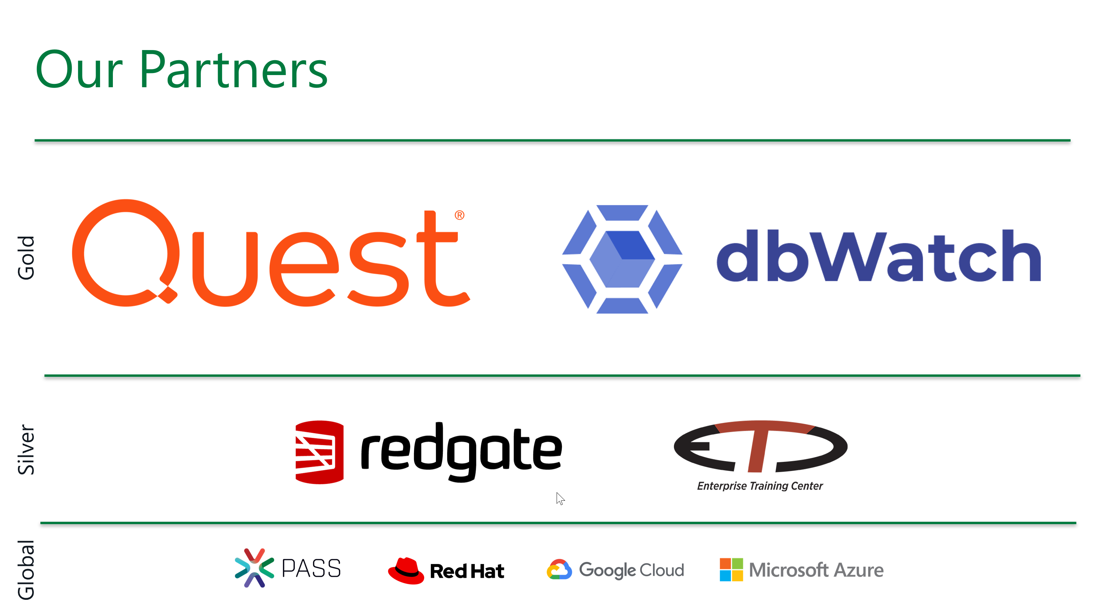

Slide 4
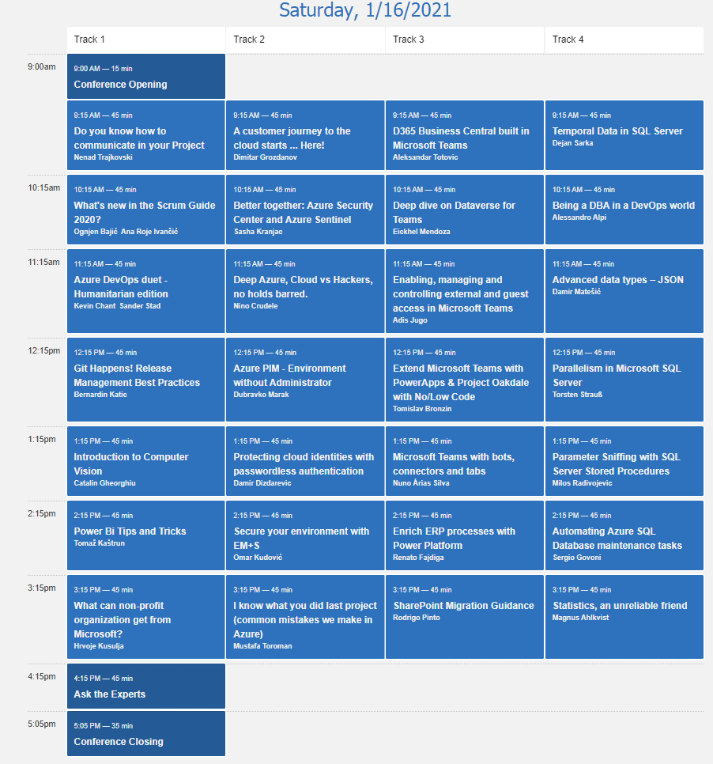
MVPs for Croatia
https://mvps4croatia.com/

Slide 5









contact information
(he/him/his)
koen dot verbeeck at ae dot be
@Ko_Ver
LinkedIn
https://sqlkover.com
Notes:
Introduce yourself but keep it short. Mention your years of experience and how they can reach you.

Slide 6
agenda
self-service BI – blessing or a curse?
data modeling 101
tips & tricks

Slide 7
NOBODY SAID IT WAS EASY
Notes:
Inspirational quote

Slide 8
self-service BI – blessing and a curse
“Go from data to insights in minutes. Any data, any way, anywhere. And all in one view.”
“… xxx makes it easy to get value from data.”
“Freely search and explore across all your data, instantly pivoting your analysis when new ideas surface. You're not restricted to linear exploration within partial views of data.”
“Prep, blend, and analyze all of your data in a repeatable workflow, and deliver deeper business insights in hours, not weeks.”
“Magic ETL lets even non-technical users cleanse and combine data from anywhere—no coding required. Plus, data flows update automatically, so you always have the latest data at your fingertips.”
Notes:
I especially like the “magic ETL”. Typically this works the first time, but once the data schema changes, business users have to repeat the exercise.

Slide 9

Notes:
Vendors make it seem you get a BI sportscar. Everything will be done for you, it will cost you no effort and magic fairies will deliver you insights and numbers within the blink of an eye.

Slide 10
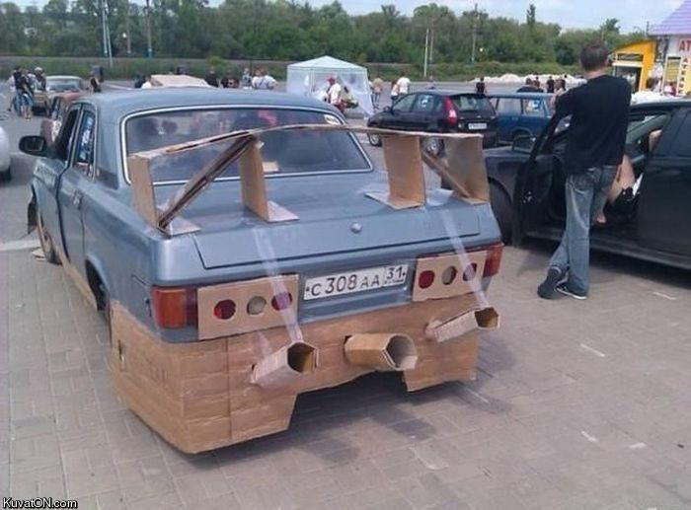
Notes:
In reality however creating a decent BI environment still is a lot of work.
Data Quality, data governance, master data, complex calculations, scaling, performance, data prep…

Slide 11
feedback
“cheap and easy to use”
“less dependency on IT for reports”
“you can make changes in data model without touching corporate data warehouse”
“easy reports are created very quickly”
“frequent updates + nice features”
Notes:
The good stuff!

Slide 12
feedback
“you still have to know the data model. It’s still not easy for the business to get insights”
“we still have to analyze which fields are needed and which aren’t”
“complex reports are still difficult to create”
“it’s not easy to export reports or send them over by e-mail"
Notes:
The bad stuff…

Slide 13


Notes:
There’s still an Excel hell, but maybe in a slightly different version…

Slide 14


report with parameters
pivot table in Excel
true self-service BI/analytics
Notes:
self-service has layers. Like an onion.

Slide 15


Slide 16

data modeling 101
Notes:
a good data model does the heavy lifting for you

Slide 17
a good data model will make querying and writing calculations easier
Notes:
Inspirational quote

Slide 18
data modeling 101
Notes:
Inspirational quote

Slide 19
one big table approach
1
easy to model
only one granularity possible
not ideal for performance
what if you want to add data later on?
Notes:
difficult to add new data (a new fact table). Difficult to put relationships in.

Slide 20
normalization
process of restructuring data to
reduce data redundancy
improve data integrity
typically 3rd Normal Form is used
fast for updates and inserts

Slide 21
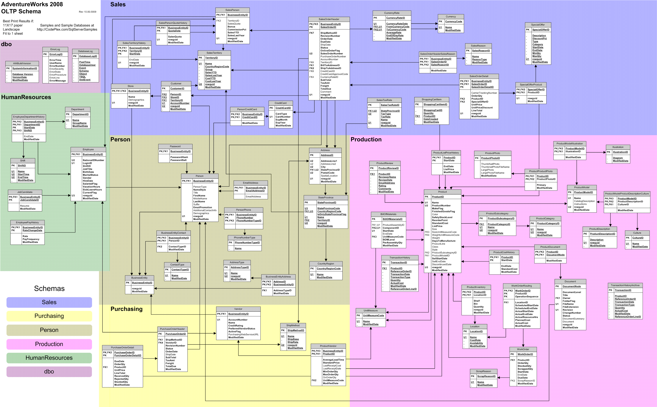

Slide 22
problems with normalization
hard to query the model
performance
complicated DAX
can introduce ambiguity in the model
→ often used in your source databases

Slide 23
DEMO downside of OBT & normalization

Slide 24
dimensional modeling
denormalize data
facts & dimensions
use dimensions to link fact tables together

Slide 25
dimension
descriptive data
typically a lot of columns
number of rows are typically lower (10s to 1000s)
e.g. time, product, customer, employee

Slide 26
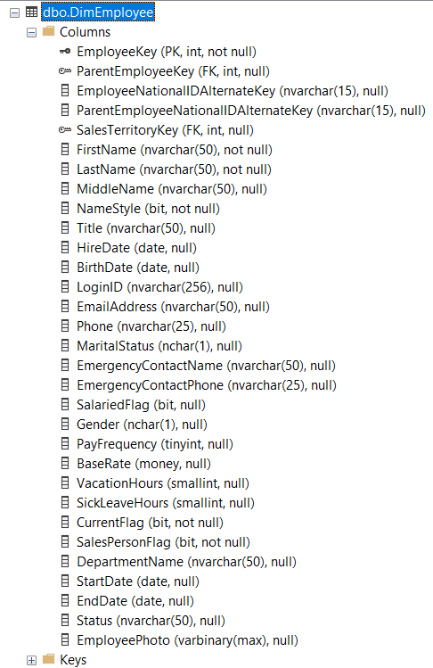

Slide 27
fact
stores the measurements of a business process
number of columns typically lower than dimension
lots of rows
e.g. sales, accounts receivable, inventory, interactions

Slide 28
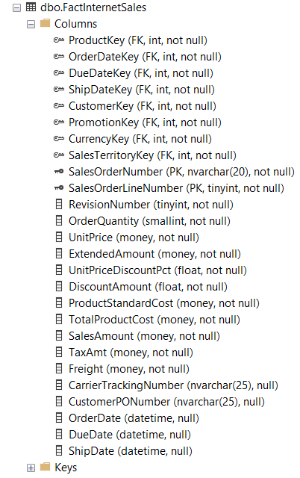

Slide 29
star schema
employee
date
product
sales
store
customer

Slide 30
snowflake
employee
date
product
sales
store
customer
geography

Slide 31
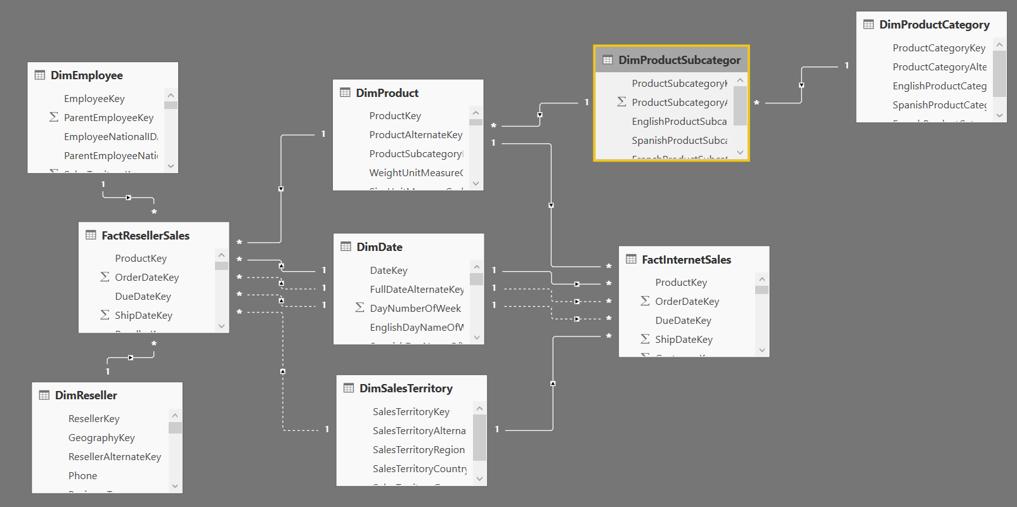
Notes:
Conformed dimensions are the backbone of your dimensional model.

Slide 32
relationships
nervous system of the data model
dictates how filtering flows through the model
single direction or bi-directional
date
year = 2017
all sales made in the year 2017
sales

Slide 33

granularity
level of detail at which data is kept
defined by the number of dimensions in the fact table
fact tables can have different grains
too high -> many aggregations needed
too low -> loss of precision

Slide 34
DEMO why relationships matter

Slide 35
many to many relationships
Customer | Account
A | alpha
B | alpha
B | beta
C | gamma
Account | Amount
alpha | €100
beta | €200
gamma | €50
Customer | Amount
A | €100
B | €300
C | €50
Total | €350

Slide 36
many to many relationships
dimension
X
AccountKey | Account
1 | alpha
2 | beta
3 | gamma
bridge table
AccountKey | CustomerKey
1 | 1
1 | 2
2 | 2
3 | 3
dimension
CustomerKey | Customer
1 | A
2 | B
3 | C
AccountKey | Amount
1 | €100
2 | €200
3 | €50
fact

Slide 37
DEMO many-2-many relationships show effect of wrong granularity

Slide 38

tips & tricks

Slide 39
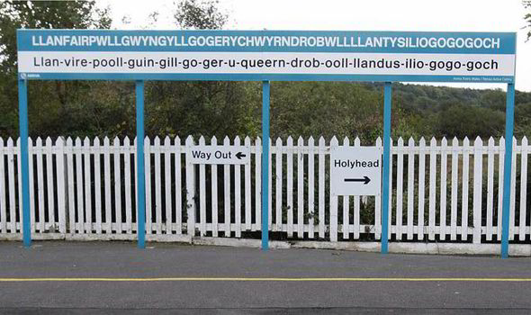
give objects a decent name
Notes:
Your data model is the user interface.

Slide 40

hide everything not essential

Slide 41
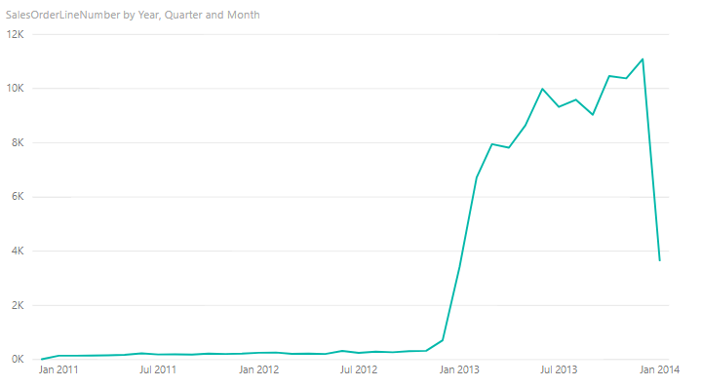
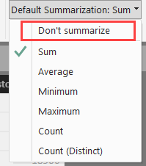
choose correct data type
Notes:
And set correct default aggregation

Slide 42
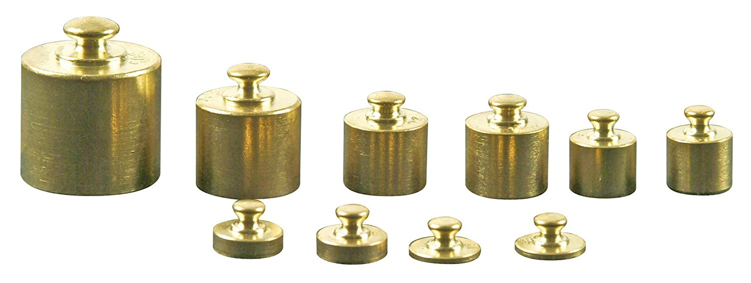
size matters
Notes:
Choose the correct data type.

Slide 43

DAX naming convention
measures don’t have a table name: [Net Sales]
columns have a table name: F_Sales[Net Sales]

Slide 44
STAR SCHEMA ALL THE THINGS
Notes:
Inspirational quote

Slide 45

resources
Russo & Ferrari - Analyzing Data with Microsoft Power BI and Power Pivot for Excel (also check out their course or classes here)

Slide 46
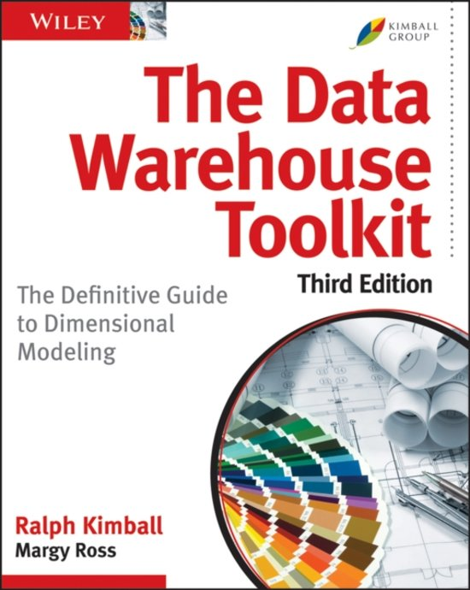
resources
Kimball – The Data Warehouse Toolkit

Slide 47

resources
Adamson – Star Schema The Complete Reference

Slide 48
questions?
koen dot verbeeck at ae dot be
@Ko_Ver
LinkedIn

